Slide 1
Chapter 7 Discrete Probability
Section 3
Bayes’ Theorem

Slide 2
Outline
Introduction
Bayes’ Theorem

Slide 3
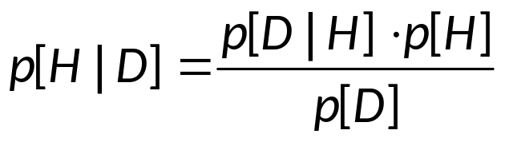

Introduction
Bayes’ Rule
  One way to compute the probability that a hypothesis H is correct, given some data D:
  This follows directly from the definition of conditional probability.
  Can you prove it?
    By the definition of Conditional Probability:
    p(H∩D) = p(H|D)p(D) = p(D|H)p(H)
  Rev. Thomas Bayes, 1702-1761

Slide 4
Introduction
Bayes’ Rule
  This rule is the foundation of Bayesian methods for probabilistic reasoning, which are very powerful, and widely used in artificial intelligence applications:
    For data mining, automated diagnosis, pattern recognition, statistical modeling, even evaluating scientific hypotheses.
Examples.
  What is the likelihood that people who test positive to a particular disease (e.g., HIV), actually have the disease?
  What is the probability that an e-mail message is spam?

Slide 5
Introduction
Remark.
  We know P(F) - probability that event F occurs
    (e.g. probability that email message is spam; this is given by what fraction of email is spam)
  We also know event E has occurred.
    (e.g., email message contains words “sale” and “bargain”)
  Therefore the probability conditional probability that F occurs given that E occurs, P(F|E), is a more realistic estimate that F occurs than P(F).

Slide 6
Introduction
Remark.
E
Evidence
Bayesian
Inference
Original Belief
(Prior Probability)
Modified
Belief
Hypothesis
Theory
P(F)
P(F|E)

Slide 7
Introduction
Example.
  Pick one box at random (p = 0.5) and than a ball at random from that box. Assume you picked a red ball. What’s the probability that it came form the left box?
Box A
Box B
  Define:
    E – you choose a red ball. (therefore ~E – you choose the green ball)
    F – you choose the left box. (therefore ~F– you choose the right box)
  We want to know P(F|E)

Slide 8
Introduction
Box A
Box B
  What we know: P(E|F) = 7/9; P(E|~F) = 3/7
  Given that the boxes are selected at random: P(F)=P(~F)=1/2
  P(F|E) = P(E∩F)/P(E) if we know P(E∩F) and P(E).
  From P(E|F) = P(E∩F)/P(F) we have P(E∩F) = P(E|F) P(F) = 7/9 * 1/2 = 7/18.
  Note that P(E) = P(E∩F) +P (E∩~F) (Why?)
  Note also that P (E∩~F) = P(~F) P(E|~F) = 1/2 * 3/7 = 3/14
  So, P(E) = P(E∩F) +P(E∩~F) = 7/18 + 3/14 = 38/63
  Therefore P(F|E) = P(E∩F)/P(E) = (7/18) / (38/63) = 49/76 ≈0.645

Slide 9
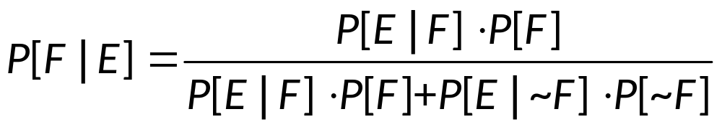
Bayes’ Theorem
Bayes’ Theorem
  Suppose that E and F are events from a sample space S such that P(E) ≠ 0 and P(F) ≠ 0. Then

Slide 10
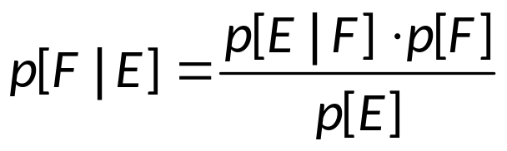
Bayes’ Theorem
  Proof.
  By Bayes’ Rule
  From E = E∩S = E∩(F∪~F) = (E∩F)∪(E∩~F) we have
  P(E) = P(E∩F)+P(E∩~F) = P(E|F)⋅P(F)+P(E|~F)⋅P(~F)
  So,

Slide 11
Bayes’ Theorem
Example.
  Suppose that 1 person in 100,000 has a particular rare disease. There is an good test for the disease that is correct in 99% of the time when given to someone with the disease; it is correct in 99.5% of the time when given to someone without the disease.
  Find:
    (1) Probability that someone who tests positive has the disease.
    (2) Probability that someone who tests negative does not have the disease.

Slide 12
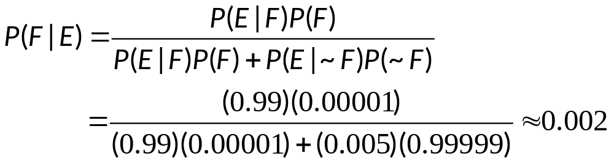
Bayes’ Theorem
  Solution.
  Start by defining the events:
    F – the person has the disease
    E – the person tests positive to the disease
    P(F) = 1/100,000 = 0.00001; P(~F) = 0.99999
    P(E|F) = 0.99; P(~E|F) = 0.01; P(E|~F) = 0.005
  (1) P(F|E) – probability of having the disease given positive test
    That is, only 0.2% of people who test positive actually have the disease

Slide 13
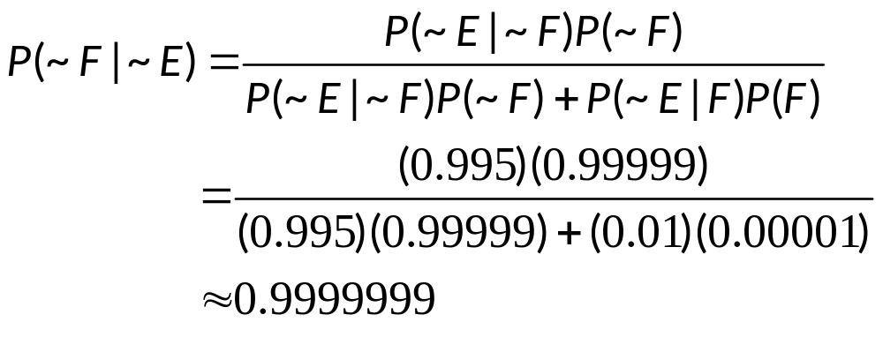
Bayes’ Theorem
  Solution.
    F – the person has the disease
    E – the person tests positive to the disease
    P(F)=1/100,000 = 0.00001; P(~F) = 0.99999
    P(E|F) = 0.99; P(~E|F) = 0.01; P(E|~F) = 0.005
  (2) P(~F|~E) – probability of not having the disease given negative test

Slide 14
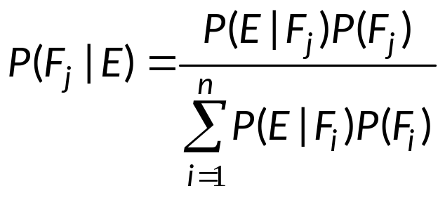
Bayes’ Theorem
Generalized Bayes’ Theorem
  Suppose that E is an event from a sample space S and F₁, F₂ ,…, F_{n} are mutually exclusive events such that
  F₁∪ F₂∪ … ∪ F_{n} = S
  Asume that P(E) ≠ 0 and P(Fi) ≠ 0 for i=1, 2,…, n. Then

Slide 15
Bayes’ Theorem
Example.
  Given two boxes: the first contains 2 blue and 7 red balls; the second contains 4 blue and 3 red balls
  Bob selects a ball by first choosing one of the two boxes, and then one ball from this box.
  If Bob has selected a red ball, what is the probability that he selected a ball from the first box.
  An event E: Bob has chosen a red ball.
  An event F: Bob has chosen a ball from the first box.
  We want to find p(F|E)

Slide 16
Bayes’ Theorem
Example.
  Example 2 in P.419 (Ver.6)

Slide 17
Bayes’ Theorem
Example. (Monty Hall Problem)
  C_{i} - The car is behind Door i, for i equal to 1, 2 or 3.
  p(C_{i}) = 1/3
  H_{ij} - The host opens Door j after the player has picked Door i, for i and j equal to 1, 2 or 3.
  Without loss of generality, assume, by re-numbering the doors if necessary, that the player picks Door 1, and that the host then opens Door 3, revealing a goat. In other words, the host makes proposition H₁₃ true.
  Then the posterior probability of winning by not switching doors is p(C₁|H₁₃). The probability of winning by switching is p(C₂|H₁₃), since under our assumption switching means switching the selection to Door 2, since p(C₃|H₁₃) = 0 (the host will never open the door with the car)

Slide 18
Bayes’ Theorem
  p(H₁₃|C₁) = 1/2, since when the car is behind Door1, and the player has picked Door1, then the host will open a door that has no car behind it, chosen from among the two not picked by the player (which are 2 and 3 here)
  p(H₁₃|C₂) = 1, since when the car is behind Door2, and the player has picked Door1, then the host will have only Door3 to be chosen and the happening of H₁₃ is ascertained.
  p(H₁₃|C₃) = 0, since when the car is behind Door3, the host will never open Door3.

Slide 19
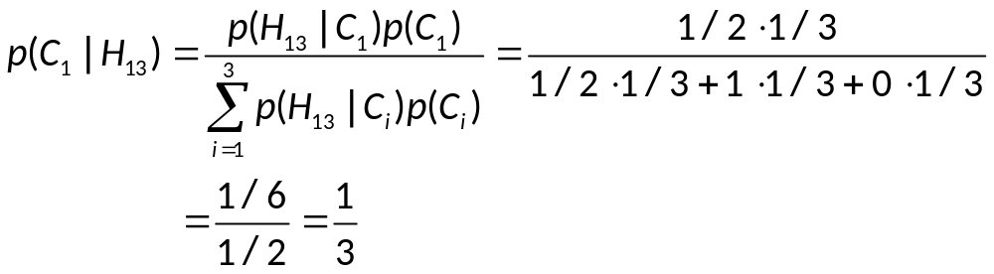
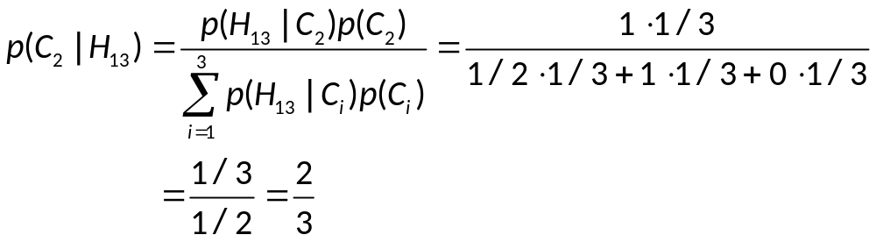
Bayes’ Theorem
  p(H₁₃|C₁) = 1/2, p(H₁₃|C₂) = 1, p(H₁₃|C₃) = 0.

Slide 20
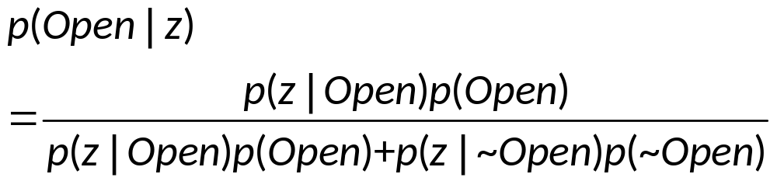
Bayes’ Theorem
Example. (State Estimation)
  Suppose a robot obtains a measurement z to decide whether the door is open. What is p(Open|z).
  p(Open|z) is diagnostic and p(z|Open) is causal. Often causal knowledge is easy to obtain (e.g., by counting frequencies).
  Bayes’ rule allow us to get the diagnostic result by making use of causal knowledge.

Slide 21
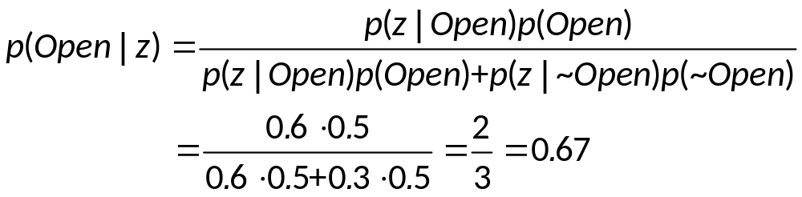
Bayes’ Theorem
  Assume that
  p(z|Open) = 0.6
  p(z|~Open) = 0.3
  p(Open) = p(~Open) = 0.5
  Then
  We find that the measurement z raises the probability that the door is open.

Slide 22
Assignment
Exercises after 7.3: No.

